Slide 1


STEEL INDUSTRY
ENERGY CONSUMPTION PREDICTION
Add subtitle here
AURORA’S DEGREE & PG COLLEGE | M.Sc. STATISTICS
J.Franklin | Shivani | Manisha | D.Sri Laxmi | K.Vaishnavi
This Photo by Unknown Author is licensed under CC BY-SA-NC

Slide 2
Abstract
The project focuses on developing a model that accurately predicts energy consumption in the steel industry, leading to more sustainable and efficient practices.
The study explores machine learning algorithms like Linear Regression, Decision Tree, Random Forest, K-Nearest Neighbours, Support Vector Machines, Bagging, and Boosting to predict power consumption.
Objective
To find the suitable machine learning model to predict the energy consumption in steel industry for implementing eco-friendly production methods.

Slide 3
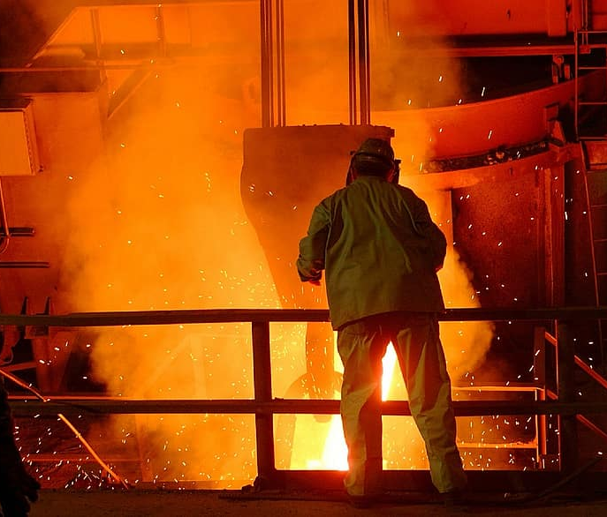
CONTENT
Objective and Abstract 2
Introduction 4
Literature Review 5
Data Preprocessing 8
Exploratory Data Analysis 12
Algorithms 21
Summary 29

Slide 4

Introduction
The steel industry is often considered an indicator of economic progress, because of the critical role played by steel in infrastructural and overall economic development.
Technological advancements: Automation and digitalization are transforming steel manufacturing, leading to improved efficiency and quality.

Slide 5
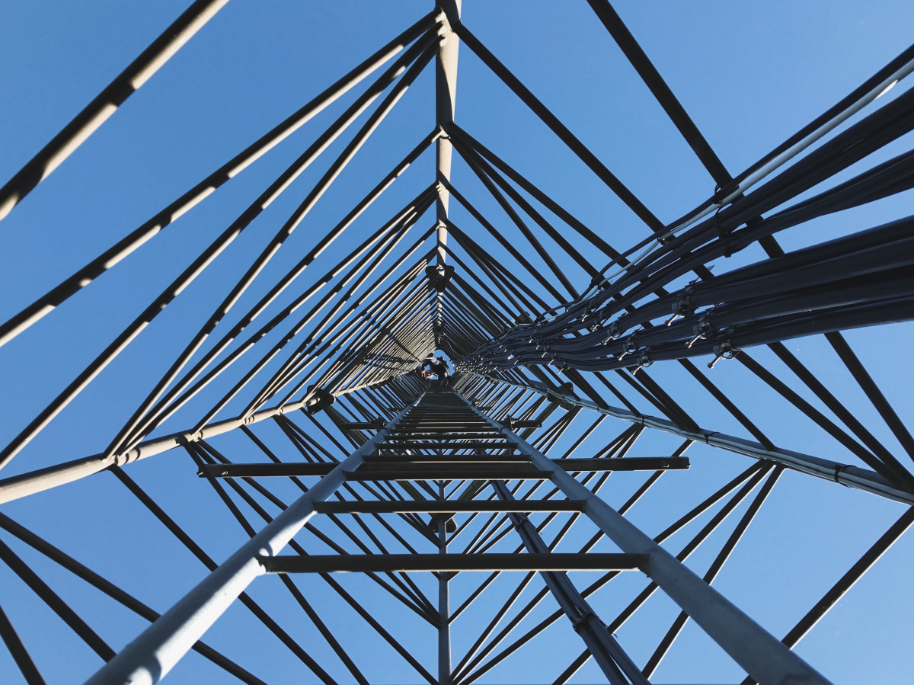
LITERATURE
REVIEW

Slide 6
Literature Review - 1
The CatBoost prediction algorithm was employed for energy consumption prediction, and hyperparameter optimization was performed using GridSearchCV with 5-fold cross-validation.
The developed model has undergone a comparative analysis based on both Root Mean Squared Error and Mean Absolute Percentage Error metrics, demonstrating its promise for accurate energy consumption prediction on both the training and test sets.
K. Karthik,
R. Dharmaprakash and
S. Sathya
https://r.search.yahoo.com/_ylt=AwrjbI0GPbxmJqcEHn1XNyoA;_ylu=Y29sbwNncTEEcG9zAzQEdnRpZAMEc2VjA3Ny/RV=2/RE=1724822023/RO=10/RU=https%3a%2f%2fwww.pubs2.ascee.org%2findex.php%2fIJRCS%2farticle%2fdownload%2f1234%2fpdf/RK=2/RS=Mv2_uR6XohqslVWnCKoUklLeGPw-

Slide 7
Literature Review - 2
In the test set, four statistical models are trained and evaluated: (a) Linear regression (LR)
(b) Support Vector Machine with radial kernel (SVM RBF)
(c) Gradient Boosting Machine (GBM)
(d) Random Forest (RF)
Root Mean Squared Error (RMSE), Mean Absolute Error (MAE) and Mean Absolute Percentage Error (MAPE) are used to measure the prediction efficiency of regression designs. When using all the predictors, the best model RF can provide RMSE value 7.33 in the test set
Sathishkumar V E
https://r.search.yahoo.com/_ylt=AwrjbI0GPbxmJqcEG31XNyoA;_ylu=Y29sbwNncTEEcG9zAzEEdnRpZAMEc2VjA3Ny/RV=2/RE=1724822023/RO=10/RU=https%3a%2f%2fkoreascience.kr%2farticle%2fCFKO201924664107981.pdf/RK=2/RS=qFTz.64dMqygj1jNNmzGM8egfRw-

Slide 8
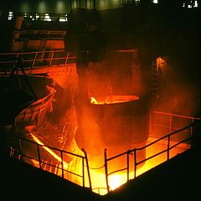
DATA
PREPROCESSING

Slide 9
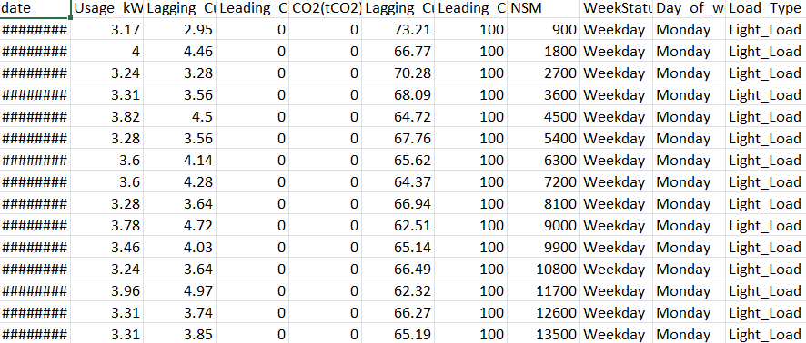
Data
Source
Our dataset was collected from uci.edu
https://archive.ics.uci.edu/dataset/851/steel+industry+energy+consumption

Slide 10
Variables
The dataset used for the prediction model comprises 11 attributes and 35,040 instances.
Here, we predict the attribute named Usage_kVarh
Categorical variables | Continuous variables
Date | Lagging_Current_Reactive.Power_kVarh
WeekStatus | Leading_Current_Reactive.Power_kVarh
LoadType | Lagging_Current_Power_Factor_kVarh
Day_of_week | Leading_Current_Power_Factor_kVarh
 | CO2(tCO2)
 | NSM
 | Usage_kVarh

Slide 11
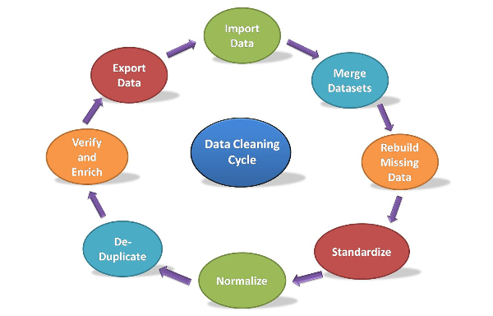
Data Cleaning
Removing Columns: As there are same dates with different time stamps we deleted the column named date from the data.
Checked for missing values and unique values
Enlabled and Dummified the categorical variables: Enabled weekday and weekend from the variable WeekStatus to 0 and 1 respectively
Refer Appendix page 34

Slide 12
To perform dummy variable encoding we divided the data into two sets
- continuous data
- categorical data
Renaming the columns names
Original variable names | Renamed variable names
Lagging_Current_Reactive.Power_kVarh | LaRP
Leading_Current_Reactive.Power_kVarh | LeRP
CO2(tCO2) | CO2
Lagging_Current_Power_Factor_kVarh | LaPF
Leading_Current_Power_Factor_kVarh | LePF
Maximum _Load | MaxL
Minimum_Load | MinL
Light_Load | LL
Usage_kVarh | Usage
Refer appendix page number 35

Slide 13
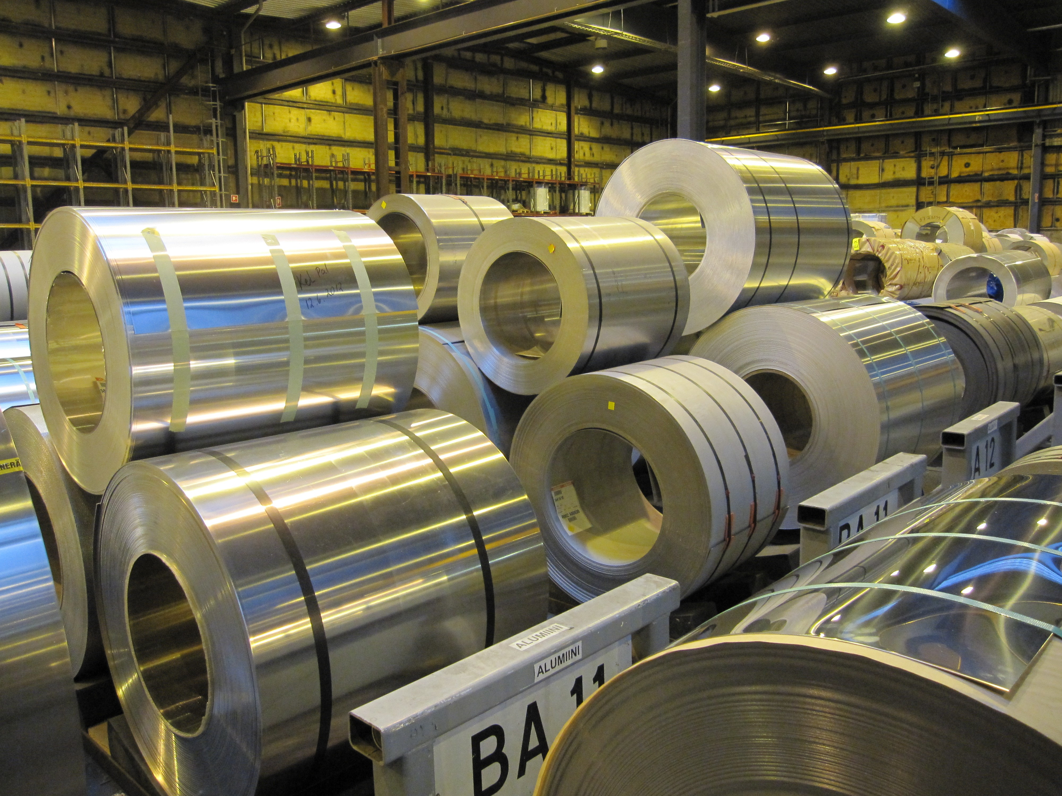
EXPLANATORY
DATA
ANALYSIS

Slide 14
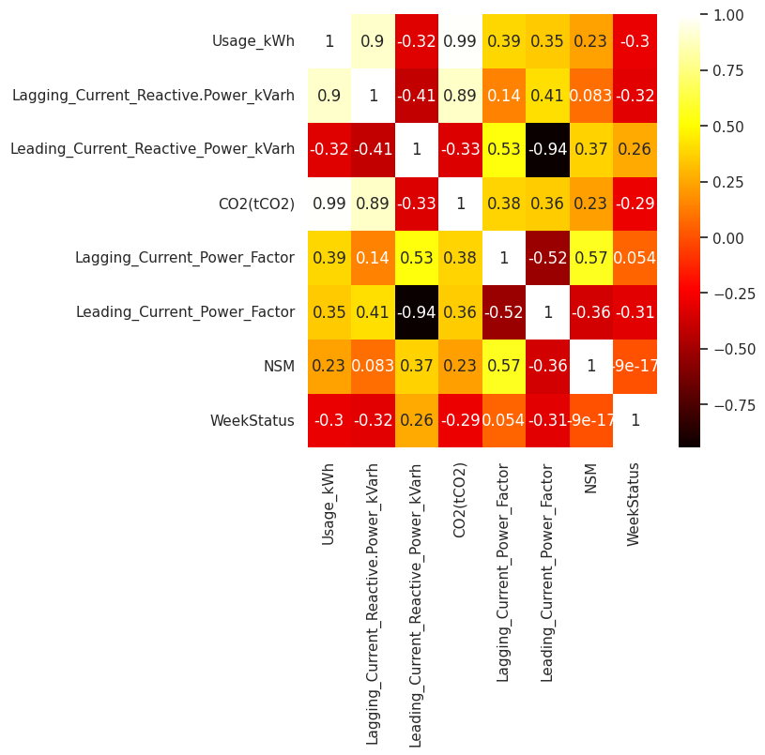
We can observe Usage and CO2 are most positively correlated The next most positively correlated variables are Lagging current reactive power and usage
Correlation Matrix

Slide 15
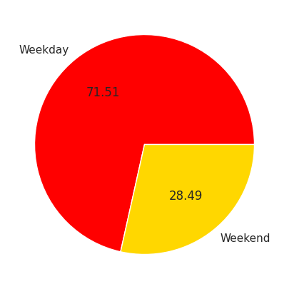
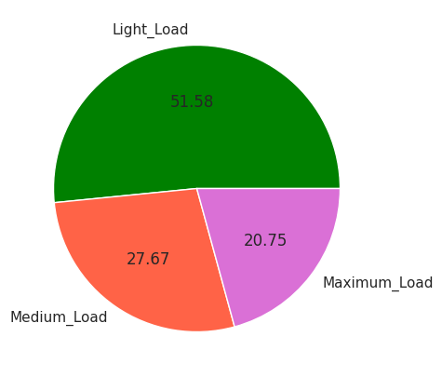
Pie Charts
WeekStatus
Load Type

Slide 16
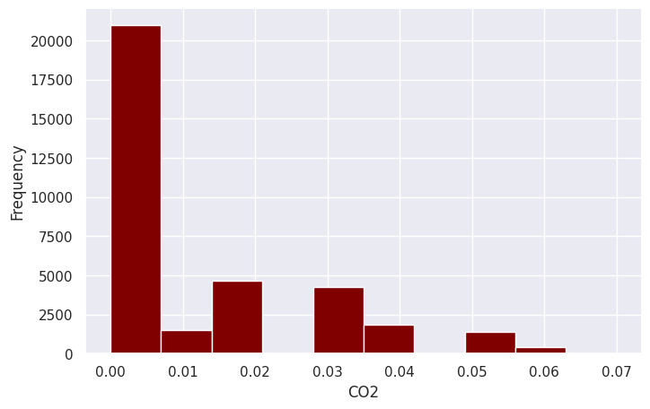
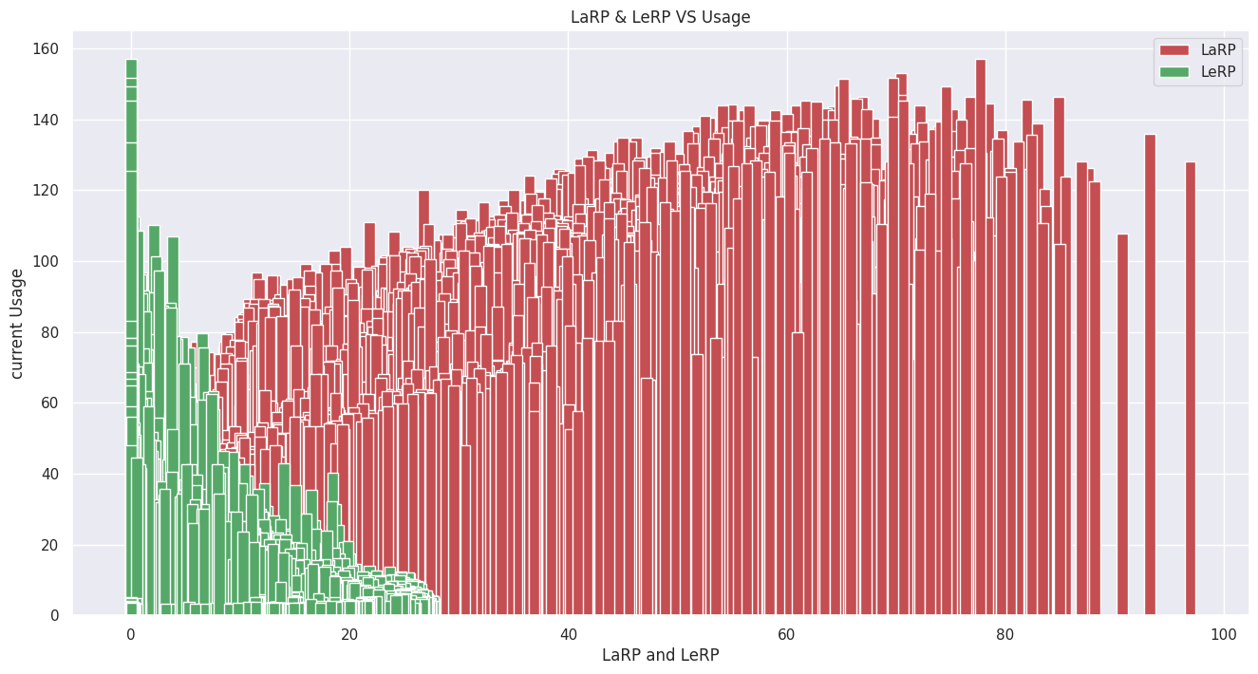
Bar Plots
As usage increases, Lagging current reactive power increases and Leading current reactive power decreases
Histogram of CO2

Slide 17
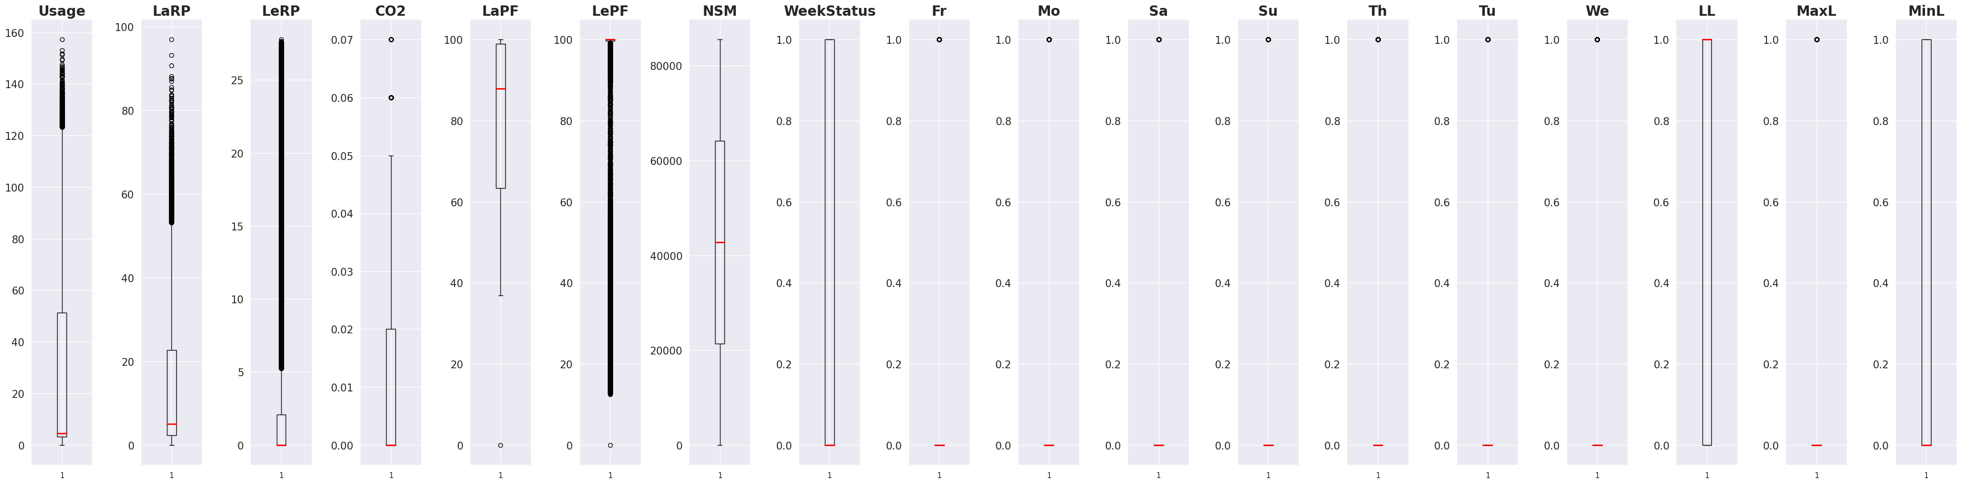
Box Plot
Leading current power factor(LePF) consists of more outliers

Slide 18
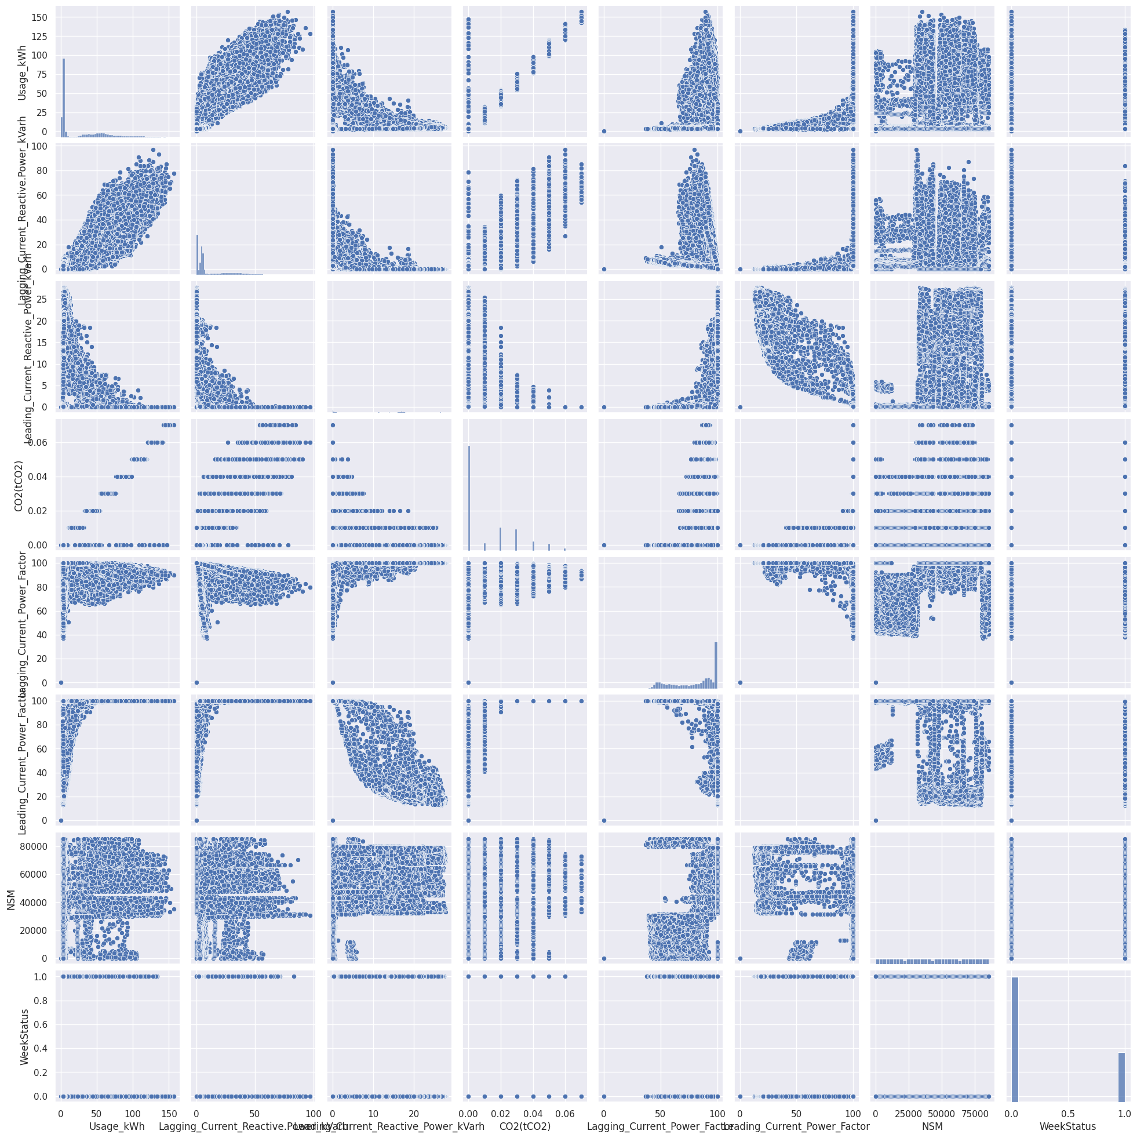
Pair Plots
Lagging current reactive power is positively correlated with respect to Usage
Leading current power factor is most negatively correlated with respect to leading current reactive power

Slide 19
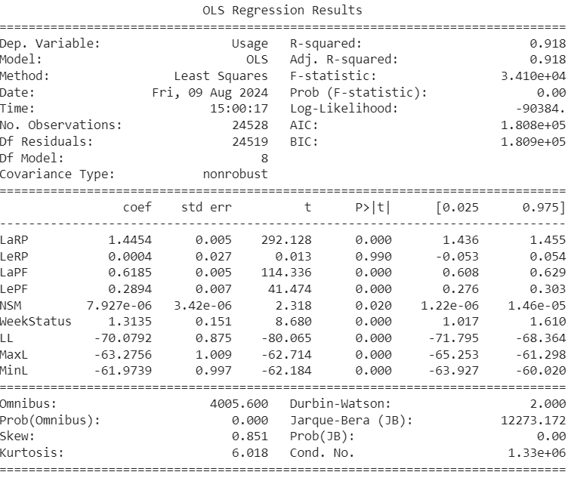
Significance Test
Fitting ordinary least squares model with all the features:
Leading Current Reactive Power(LeRP) has Greatest P-value which is insignificant

Slide 20
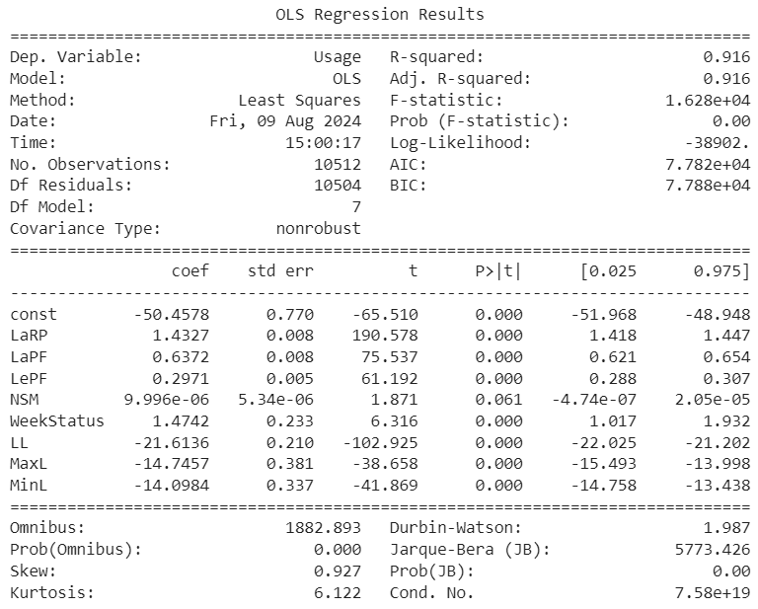
Significance Test
Removing Insignificant variables: After removing variable having greatest P-value (greater than 0.05)

Slide 21
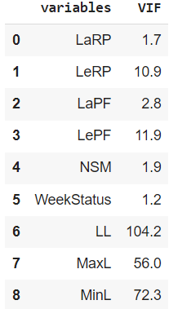
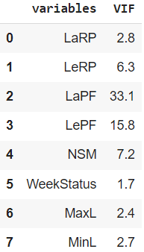
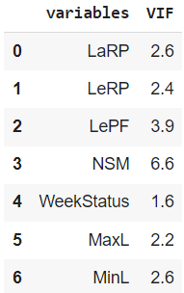
Multicollinearity Check
Variables with the greatest variance inflation factor (VIF > 10) were removed
Lagging current Power factor(LaPF) was removed
Light Load (LL) as removed

Slide 22

MACHINE
LEARNING
ALGORITHMS

Slide 23
ML Algorithms
Multiple Linear Regression
K-Nearest Neighbors(KNN)
Decision Tree
Random Forest
Bagging
Boosting
Support Vector Machine(SVM)

Slide 24
80:20 Train-Test Split
Algorithms | Model-1 (R- square) | Model-2 (R- square) | Model-3 (R- square) | Model-1 (MAE) | Model-2 (MAE) | Model-3 (MAE)
Linear Regression | 0.916 | 0.873 | 0.919 | 6.95 | 8.40 | 6.86
KNN | 0.987 | 0.988 | 0.998 | 1.54 | 1.46 | 0.64
Decision Tree | 0.894 | 0.894 | 0.895 | 5.88 | 5.86 | 5.94
Random Forest | 0.999 | 0.999 | 0.999 | 0.20 | 0.19 | 0.39
Bagging | 0.996 | 0.997 | 0.997 | 0.84 | 0.64 | 0.67
Boosting | 0.995 | 0.996 | 0.996 | 1.21 | 1.22 | 1.22
SVM | 0.907 |  |  | 0.196
Model 1: With all features | Model 2: After removing multi-collinear variables | Model 3: After removing insignificant variables from all the features

Slide 25
75:25 Train-Test Split
Algorithms | Model-1 (R- square) | Model-2 (R- square) | Model-3 (R- square) | Model-1 (MAE) | Model-2 (MAE) | Model-3 (MAE)
Linear Regression | 0.917 | 0.870 | 0.915 | 6.83 | 8.36 | 6.97
KNN | 0.984 | 0.984 | 0.997 | 1.75 | 1.76 | 0.66
Decision Tree | 0.889 | 0.895 | 0.893 | 6.17 | 5.78 | 6.03
Random Forest | 0.999 | 0.999 | 0.999 | 0.22 | 0.21 | 0.40
Bagging | 0.996 | 0.997 | 0.997 | 0.87 | 0.70 | 0.68
Boosting | 0.995 | 0.995 | 0.995 | 1.23 | 1.23 | 1.23
SVM | 0.906 |  |  | 0.198
Model 1: With all features | Model 2: After removing multi-collinear variables | Model 3: After removing insignificant variables from all the features

Slide 26
70:30 Train-Test Split
Algorithms | Model-1 (R- square) | Model-2 (R- square) | Model-3 (R- square) | Model-1 (MAE) | Model-2 (MAE) | Model-3 (MAE)
Linear Regression | 0.916 | 0.873 | 0.916 | 6.93 | 8.41 | 6.92
KNN | 0.979 | 0.980 | 0.997 | 2.02 | 1.97 | 0.65
Decision Tree | 0.895 | 0.895 | 0.894 | 5.98 | 5.93 | 5.85
Random Forest | 0.999 | 0.999 | 0.999 | 0.21 | 0.23 | 0.41
Bagging | 0.995 | 0.996 | 0.996 | 0.97 | 0.85 | 0.70
Boosting | 0.995 | 0.998 | 0.996 | 1.25 | 1.21 | 1.21
SVM | 0.906 |  |  | 0.196
Model 1: With all features | Model 2: After removing multi-collinear variables | Model 3: After removing insignificant variables from all the features

Slide 27
60:40 Train-Test Split
Algorithms | Model-1 (R- square) | Model-2 (R- square) | Model-3 (R- square) | Model-1 (MAE) | Model-2 (MAE) | Model-3 (MAE)
Linear Regression | 0.917 | 0.874 | 0.918 | 6.86 | 8.32 | 6.93
KNN | 0.973 | 0.978 | 0.997 | 2.29 | 2.09 | 0.66
Decision Tree | 0.891 | 0.893 | 0.894 | 6.07 | 5.96 | 5.97
Random Forest | 0.999 | 0.999 | 0.999 | 0.24 | 0.24 | 0.43
Bagging | 0.996 | 0.996 | 0.997 | 1.04 | 0.85 | 0.75
Boosting | 0.995 | 0.995 | 0.995 | 1.26 | 1.22 | 1.22
SVM | 0.907 |  |  | 0.195
Model 1: With all features | Model 2: After removing multi-collinear variables | Model 3: After removing insignificant variables from all the features

Slide 28
Algorithms Comparison
Algorithms | R- square | MAE
Linear Regression | 0.919 | 6.86
K- nearest numbers | 0.998 | 6.64
Decision tree | 0.895 | 5.78
Random forest | 0.999 | 0.19
Bagging | 0.997 | 0.64
Boosting | 0.998 | 1.21
Support vector machine | 0.907 | 0.195

Slide 29
SUMMARY
The purpose of this research is to determine the best-performing machine learning techniques to predict energy consumption in the steel industry.
The Random Forest(RF) model improves the Mean Absolute Error(MAE) and R-square of predictions in consideration to other regression models considered in this research

Slide 30

Work Distribution
Name | Work
Manisha | Collect information about Steel Industry
Shivani | Collected information on literature review
Franklin | Data Preprocessing
Sri Laxmi | Explanatory Data Analysis
Vaishnavi | Implement Machine Learning Algorithms

Slide 31
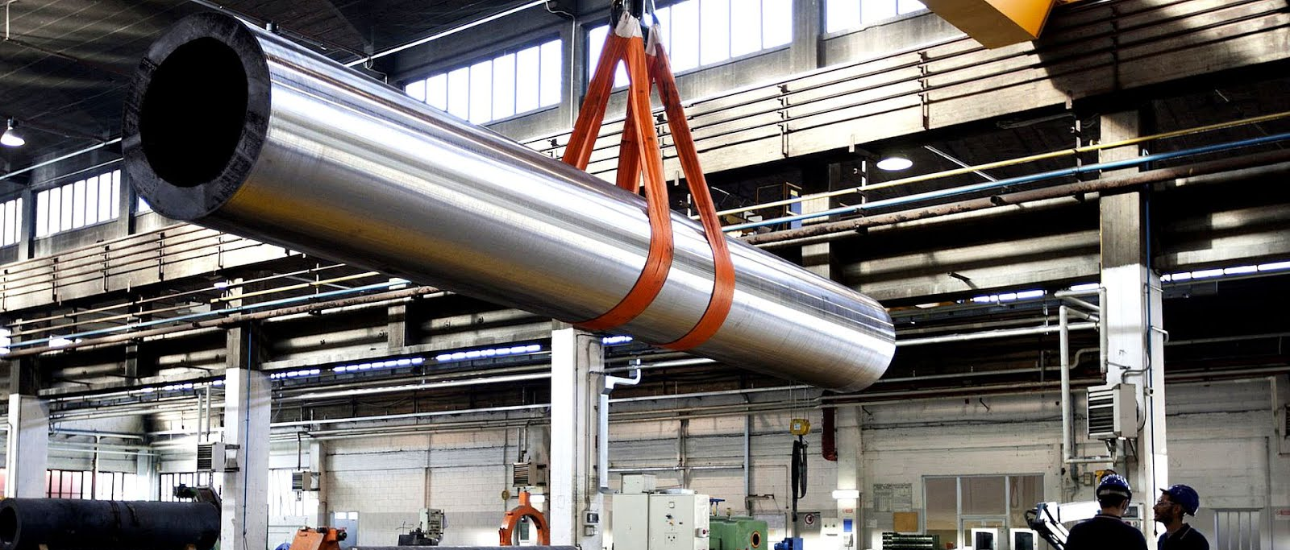
THANK YOU
J.Franklin | Shivani | Manisha | D.Sri Laxmi | K.Vaishnavi

Slide 32
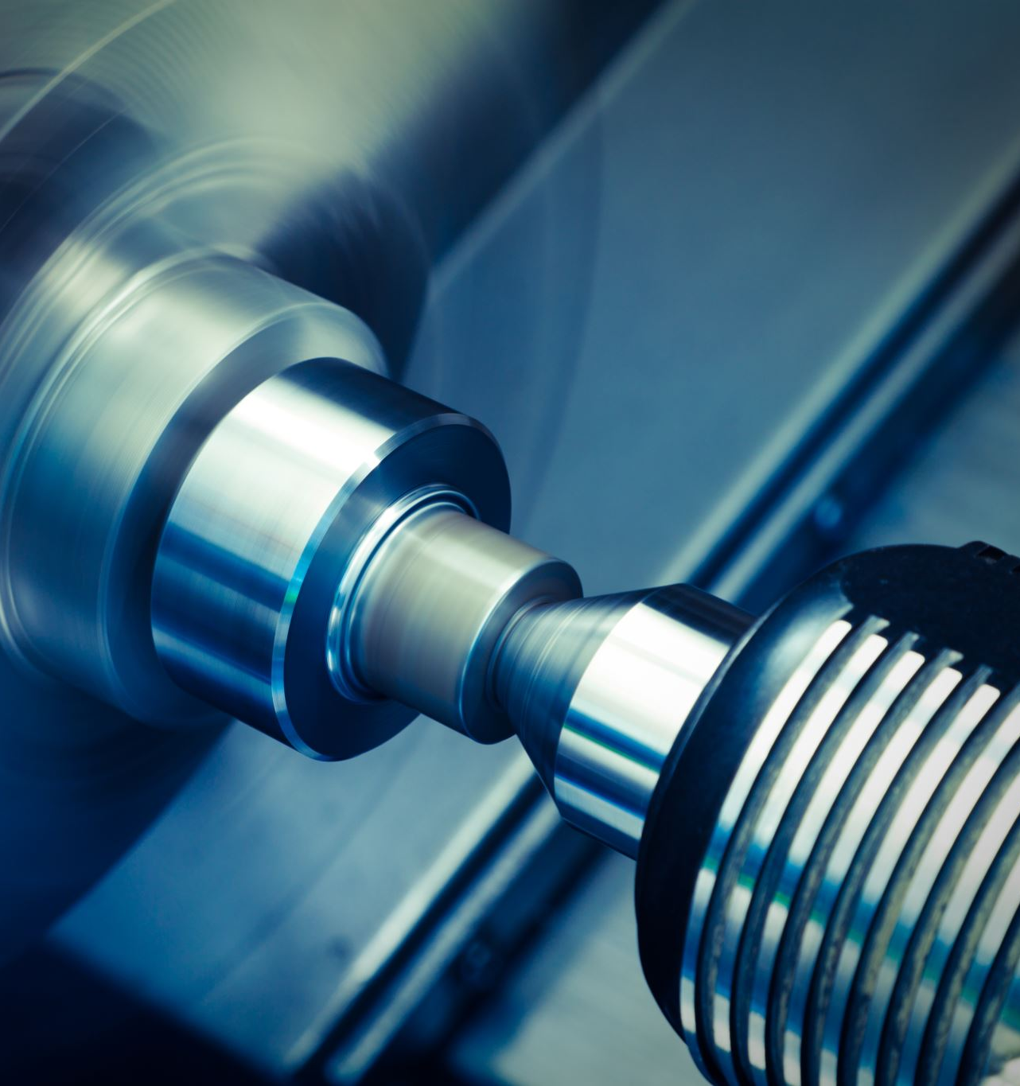
APPENDIX

Slide 33
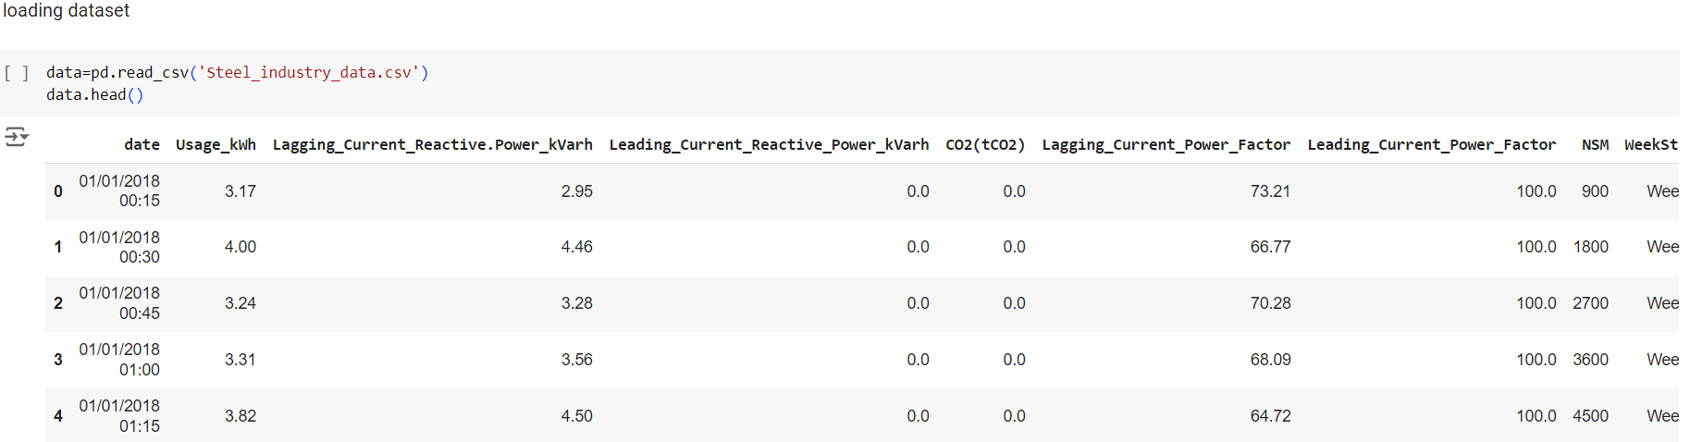
Loading the Dataset

Slide 34
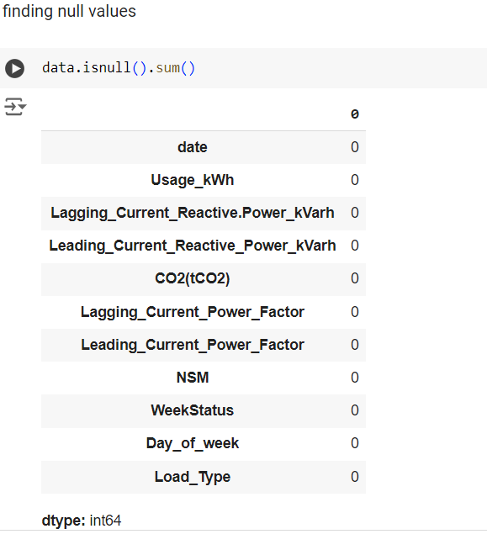
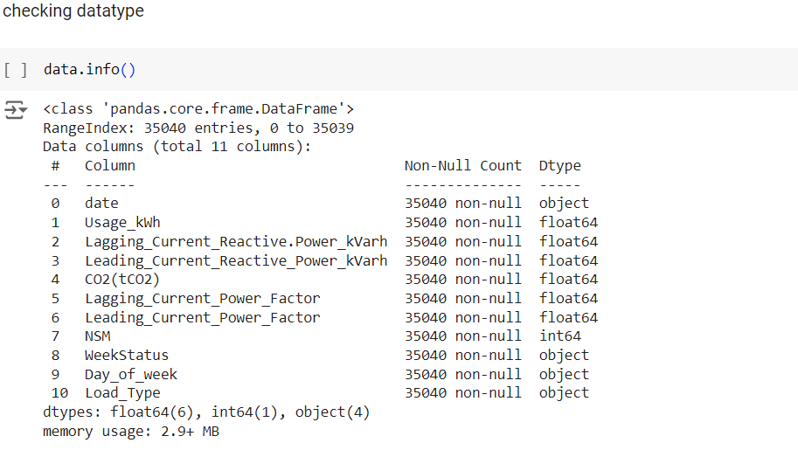
Null Values
Checking for the data type

Slide 35
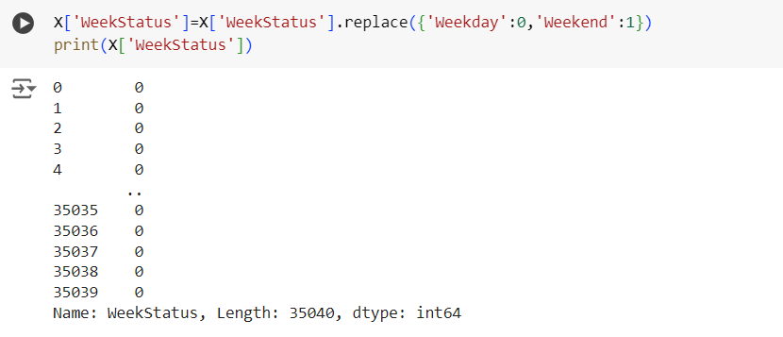
Enlabling the variable WeekStatus

Slide 36
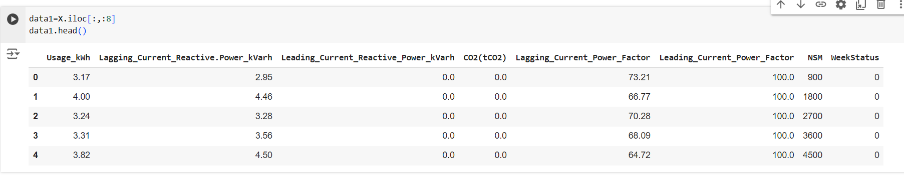
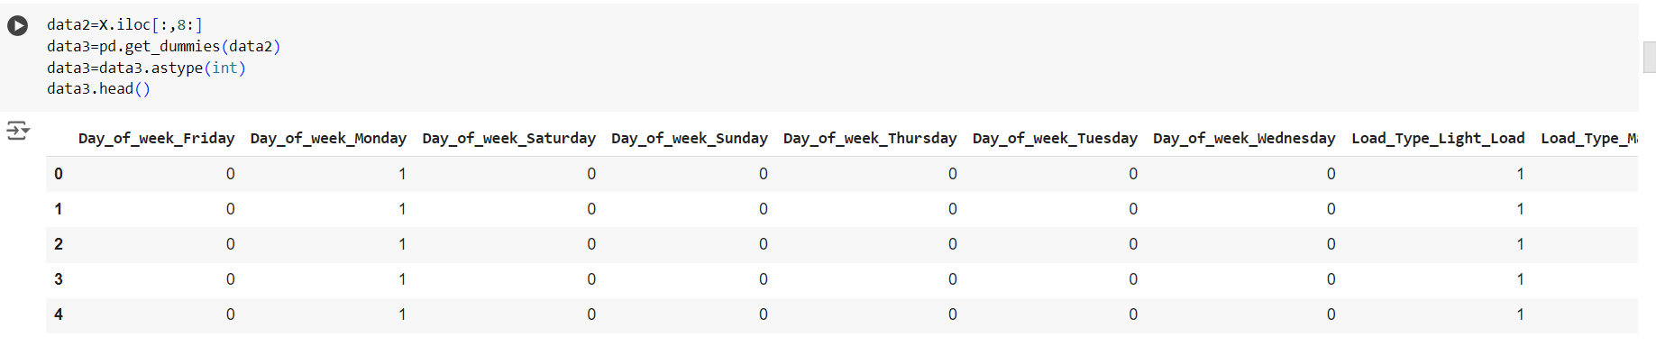
Dividing the data set
Data-1
Data-2

Slide 37
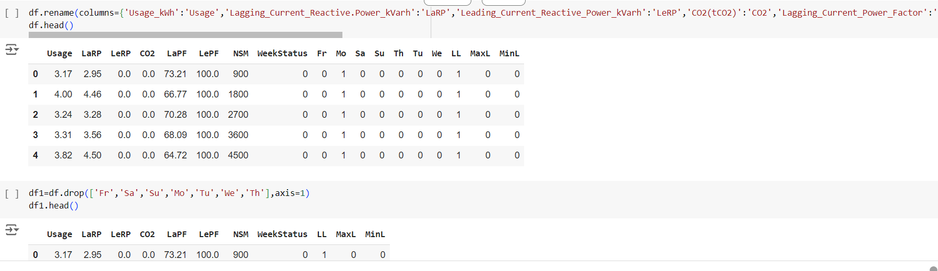
Renaming the column names and dropping the days from the data

Slide 38
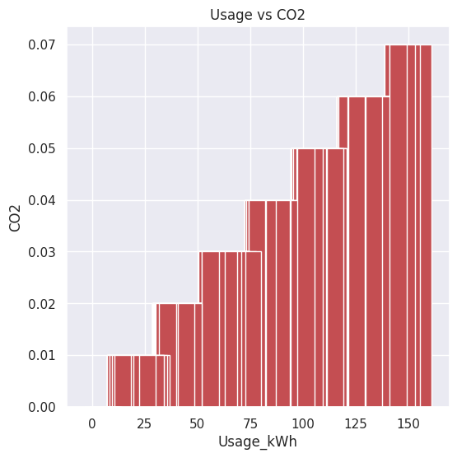
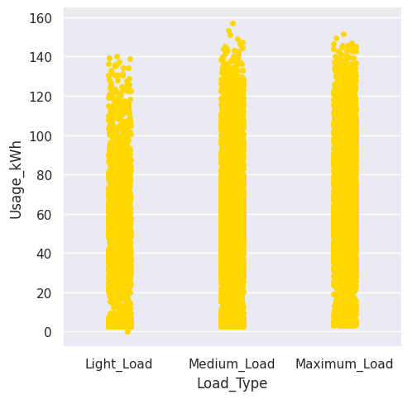
Bar Plots
plt.hist(df['CO2'],color='maroon',bins=10)
plt.xlabel('CO2')
plt.ylabel('Frequency')
plt.show()
catplot=sns.catplot(x='Load_Type',y='Usage_kWh',data=data,color='gold')
catplot.set_ylabels('Usage_kWh')
catplot.set_xlabels('Load_Type')
catplot

Slide 39
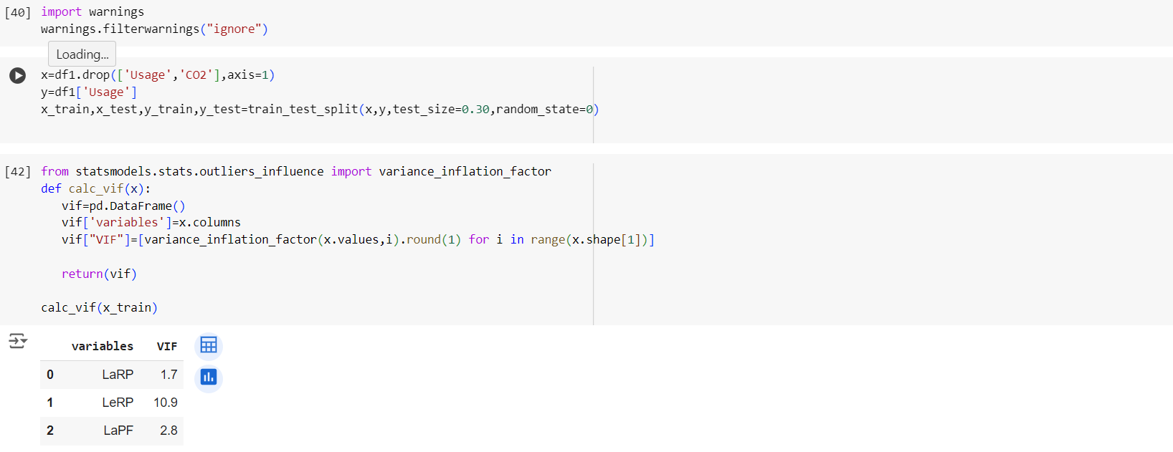
Multi collinearity check

Slide 40
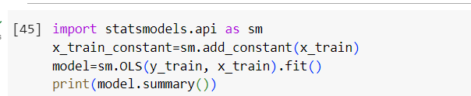
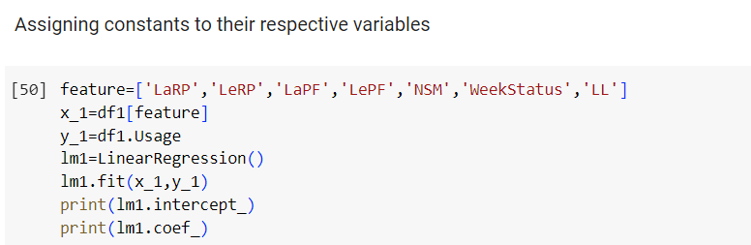
Ordinary least squares

Slide 41
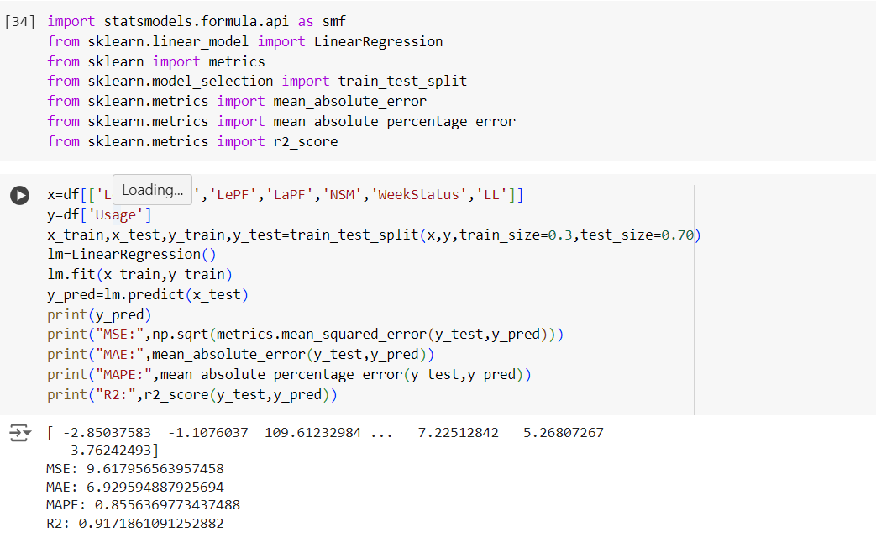
Linear Regression

Slide 42
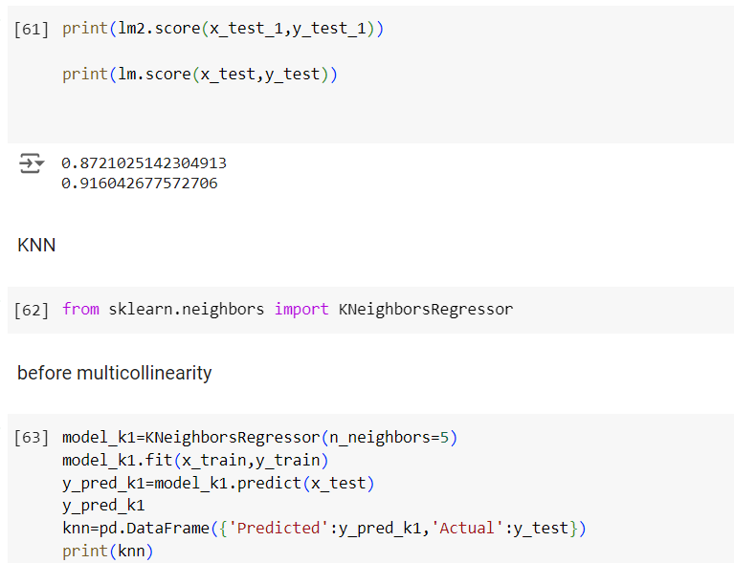
K-Nearest Neighbors

Slide 43
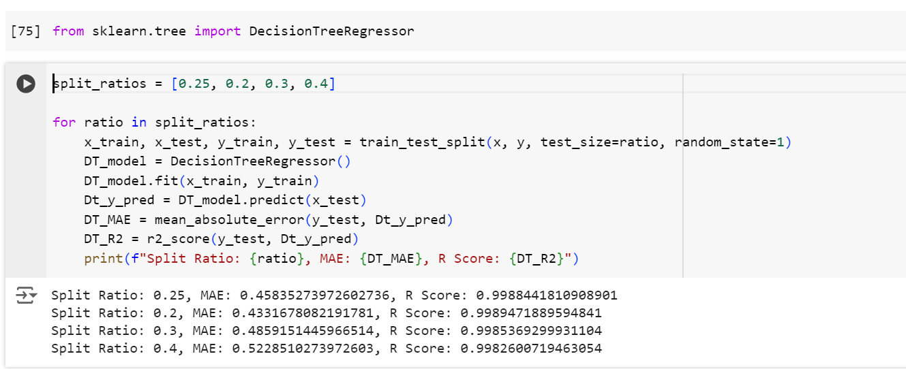
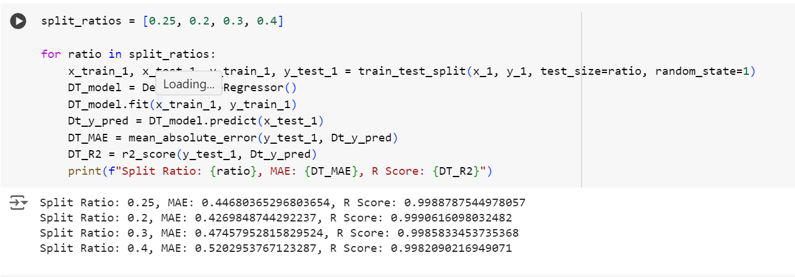
Decision tree regressor

Slide 44
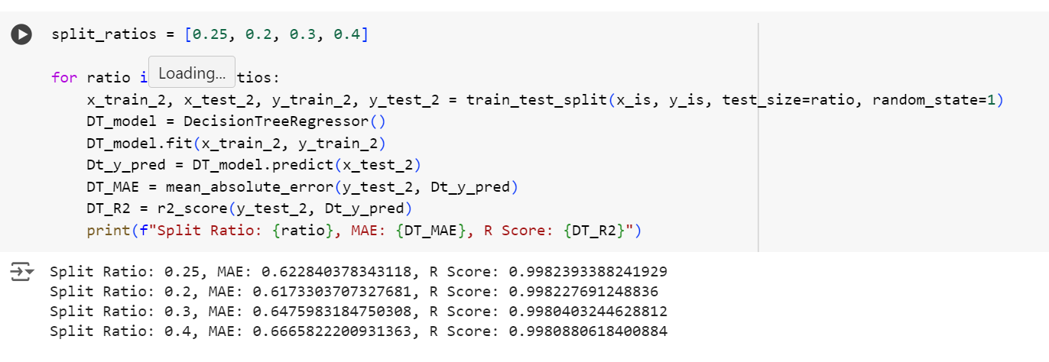
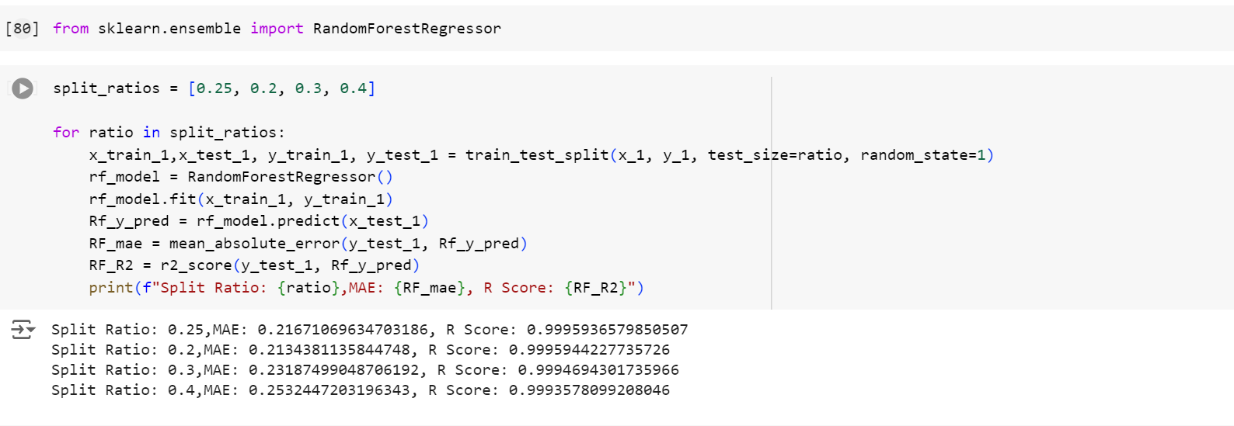
Decision tree regressor
Random forest regressor

Slide 45
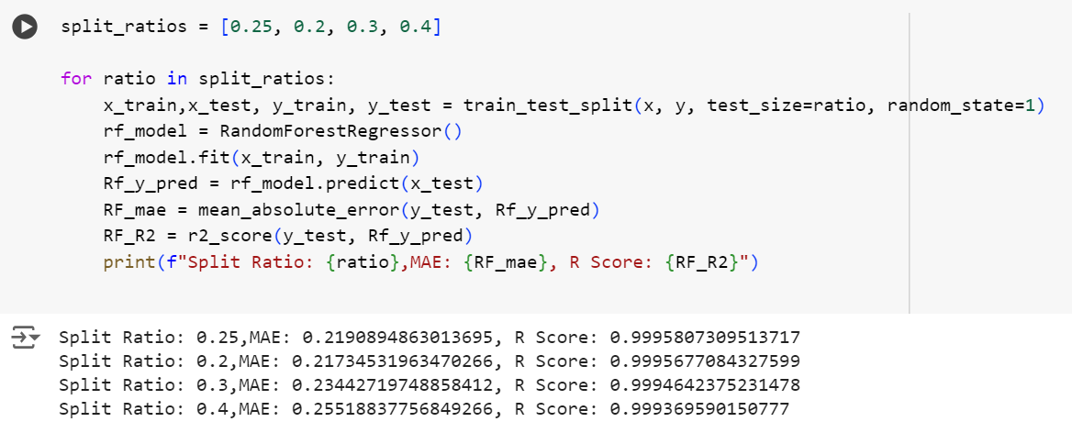
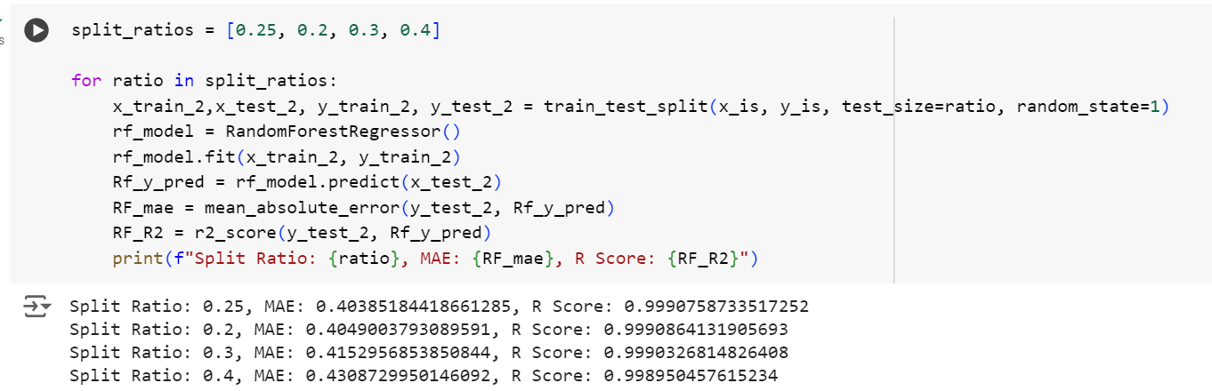
Random forest regressor

Slide 46
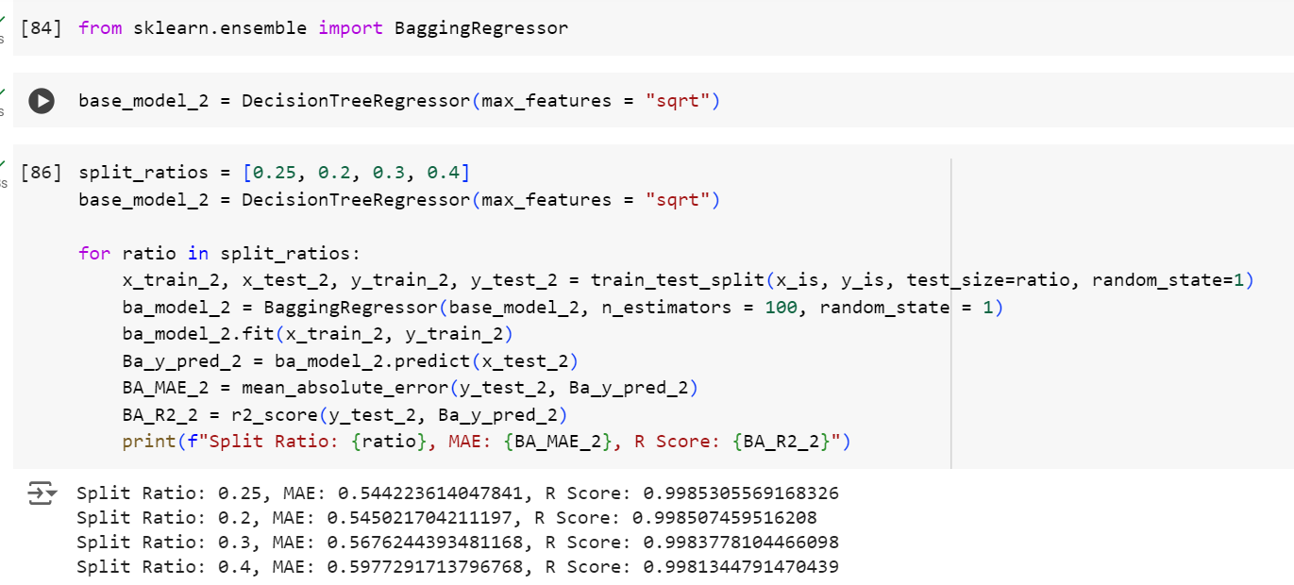
Bagging Regressor

Slide 47
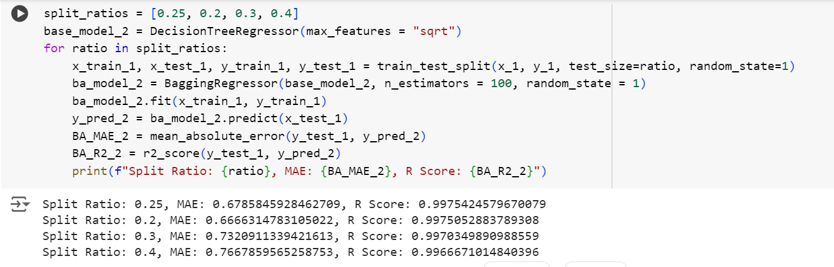
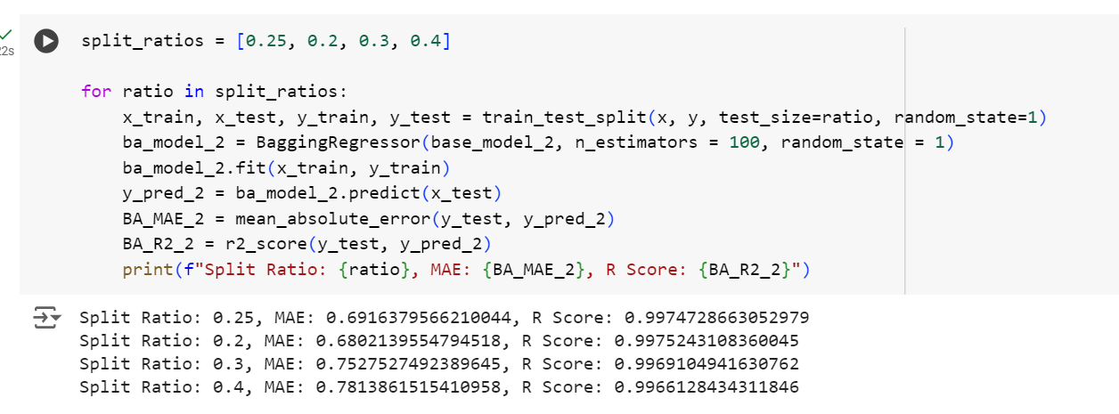
Bagging Regressor

Slide 48
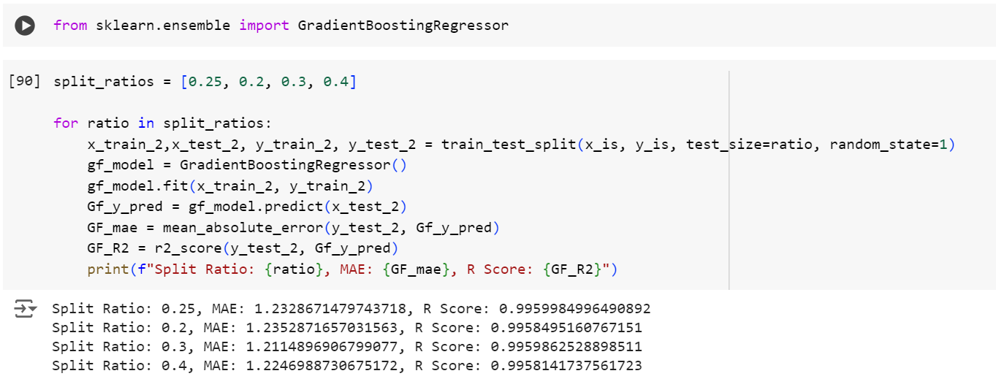
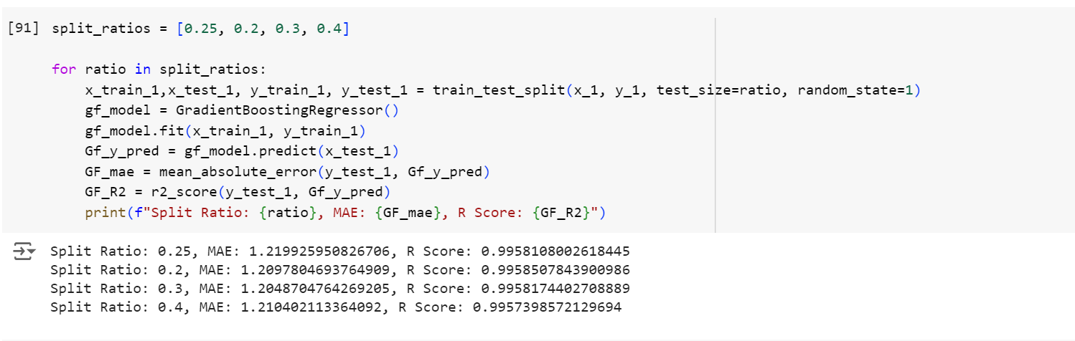
Boosting Regressor

Slide 49
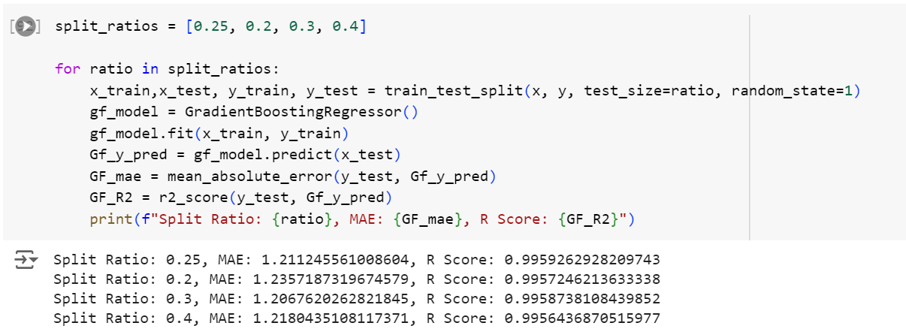
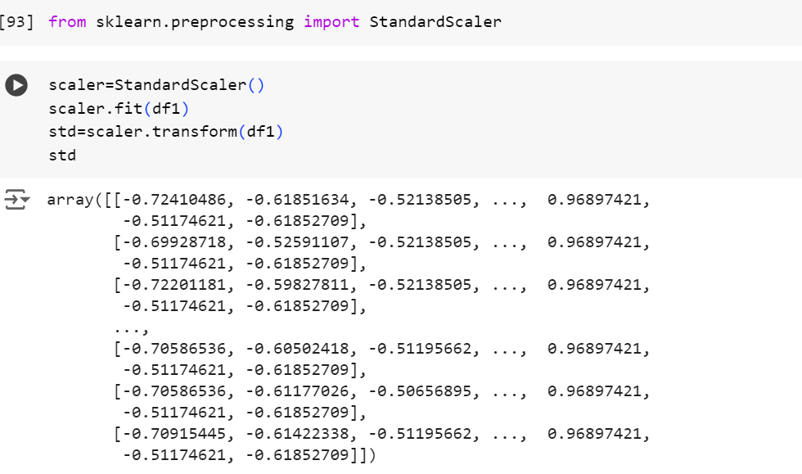
Standardizing the data

Slide 50
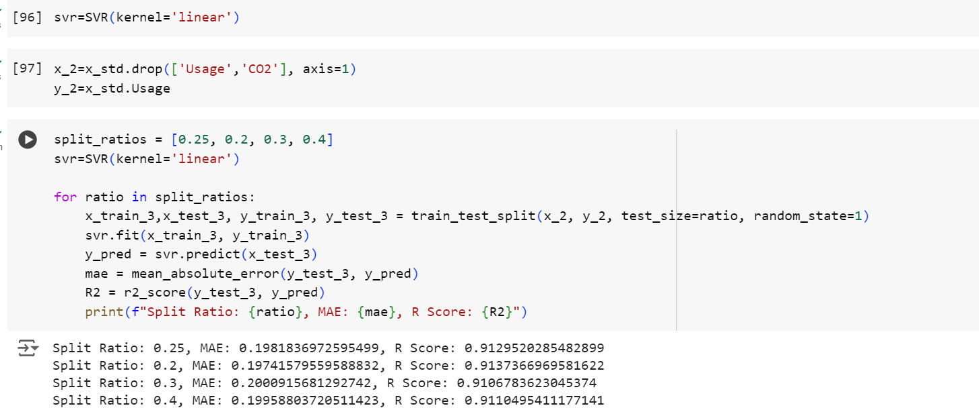
Support vector regressor

